Slide 1

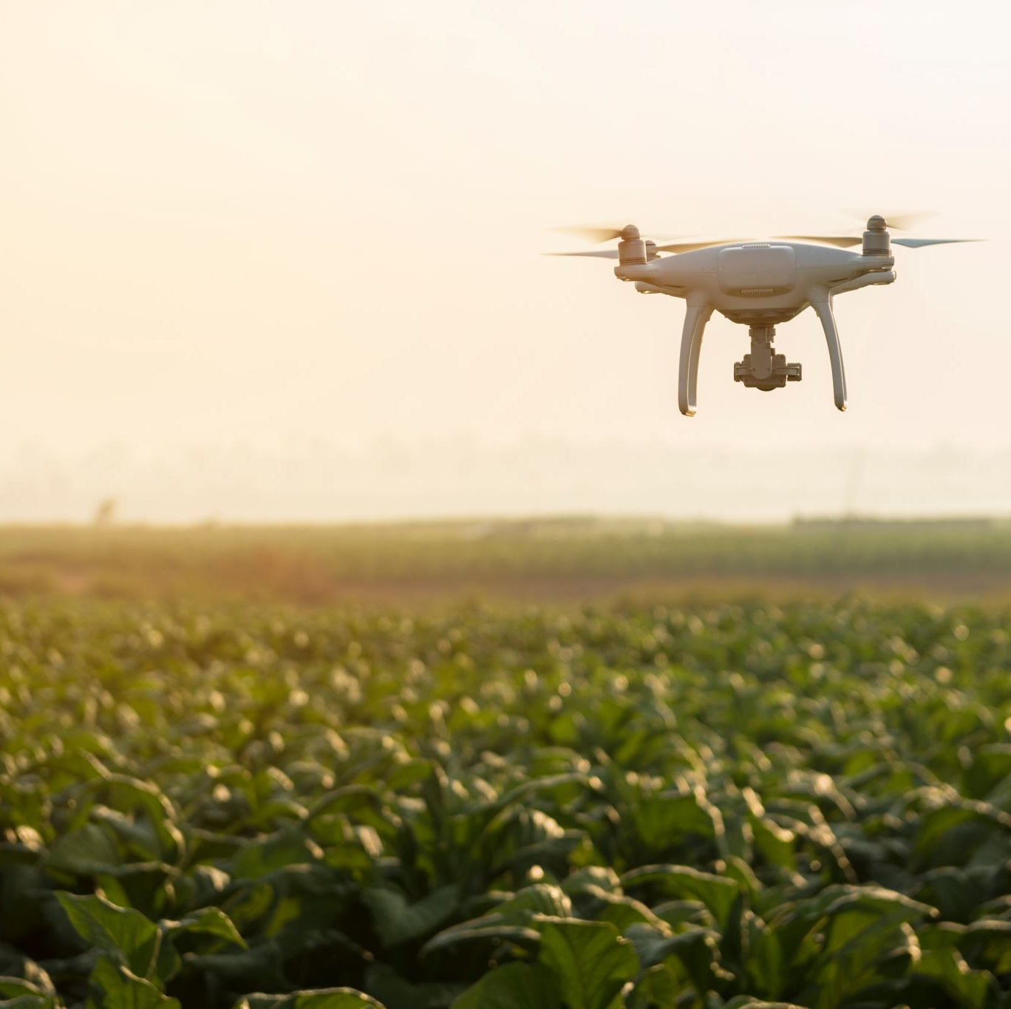
Modernizing Indian Agri Supply Chain Empowering Farmers through an Online Platform
Internship from
S4H TECHNOLOGIES,
VIJAYAWADA
Project In-charge:
S. Ravi Kumar, SAP COE
S4H Technologies
North America
Team B2: Members:
SRIHARI MADDINENI, Y20AIT507
BHARGAV KOMMINENI, Y20AIT453
POTTURI SRIRAM, Y20AIT490
THUMATI GOPI, Y20AIT511
Project Guide
Dr. B. Krishnaiah, Asst. Professor
Slide 1

Slide 2

Contents
Architecture
Modules
Data Management
User Interface
Slide 2

Slide 3
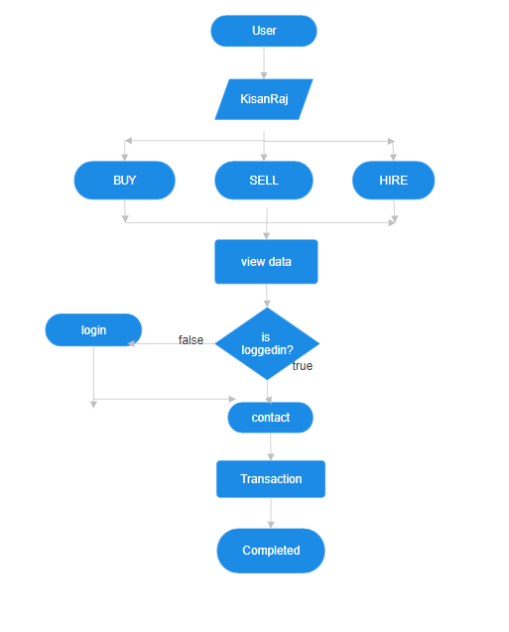
System Design
Architectural concepts
Front-end: React is a JavaScript library for building user interfaces.
Back-end: Node.js is a JavaScript runtime used for building server-side applications, while Express.js is a web application framework for Node.js, simplifying the process of building APIs and web applications.
Database: MongoDB is a NoSQL database program, which stores data in a flexible, JSON-like format, making it suitable for handling large volumes of structured, semi-structured, and unstructured data.
This stack is often used for its flexibility, scalability, and the ability to build real-time applications with JavaScript across the entire stack.
Slide 3

Slide 4



User Flow : Overview
Buyer/Provider /Agent
Farmer /Agent
Will login and post ( or )
Can go to site and see search and can make an individual request.
Will login and add the equipment
Can go to site and see search or based on saved search criteria, start responding to buyers.
This can continue as long as the negotiation is going on till both parties accepted..
3. Now Farmer Responded. Provider Responding back with his own price, quantity, quality terms, date, terms.
provider events has status ex:- Initial response, posted, response reviewed, awaiting for response.. Etc.
3. Now farmer Responded. Farmer Responding back with his own price, date, quantity, terms.
Each event has status Ex:- Initial Response Posted, Response viewed .
Event type, event status, parties involved ex:- farmer, buyer, agent etc.
Agents can see the posting requests and can subscribe to provider/farmer posts.
They can also, respond either as a provider or farmer.
Agent
Slide 4

Slide 5
Modules
Modules Included:
Buy Commodity: Allows users to browse and purchase farm products from sellers.
Sell Commodity: Enables farmers to list their farm products for sale on the platform.
Listings Posted: Shows the list of farm products listed for sale by farmers.
Responses Received for a Product: Displays the responses or offers received by sellers for their listed products.
Post Potential Requirement: Lets buyers post their requirements for specific farm products they are looking to purchase.
Slide 5

Slide 6
Contd…
Transaction History: Tracks the history of completed transactions between buyers and sellers, providing a record of purchases and sales.
Negotiation History: Records the negotiation process between buyers and sellers, capturing the exchange of offers, counteroffers, and agreements made during the transaction.
Hire Equipment: Facilitates the hiring of farming equipment by users, allowing farmers to rent out their equipment and enabling others to find and hire equipment as needed.
Post Equipment: Enables users to list farming equipment they own and are willing to rent out to other users on the platform.
Cold Storages: Provides information and listings for cold storage facilities available for rent or use by farmers and other users needing storage for perishable goods.
Slide 6

Slide 7
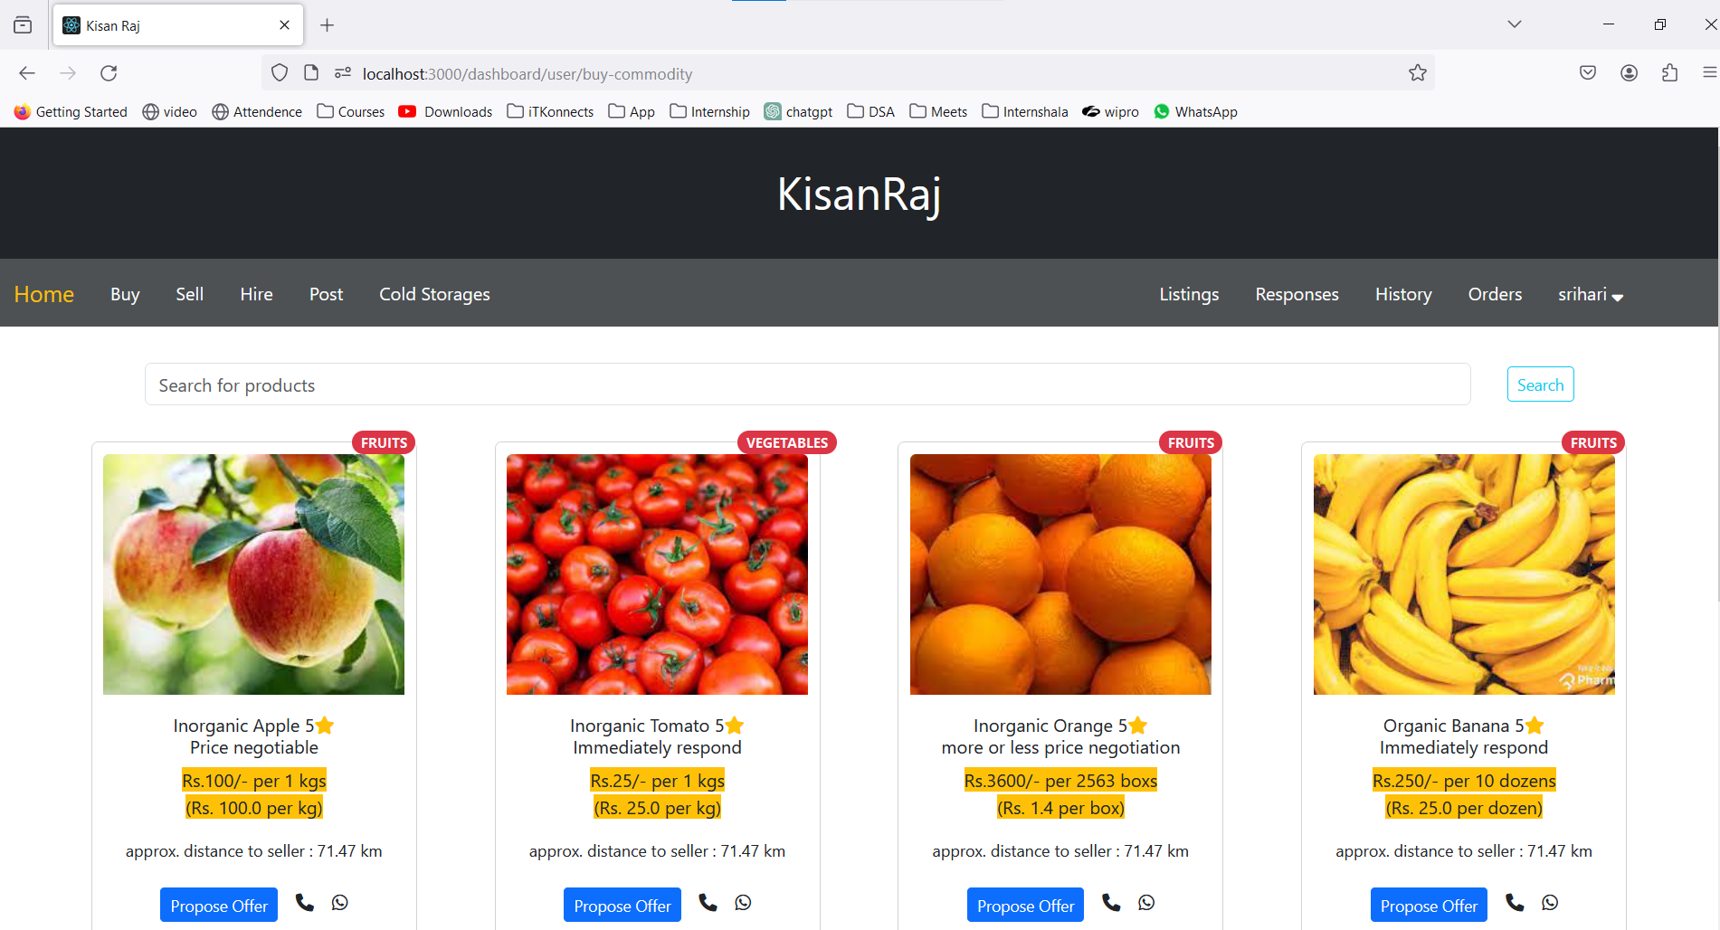
Modules : Buy Commodity
1. Product Listing: Displays all available products for purchase.
2. Search Bar: Allows users to search for specific products.
3. Filtering: Enables filtering of products based on various criteria.
4. Card View: Each product is presented in a visually appealing card format.
5. User-Friendly Interface: Provides an intuitive interface for easy navigation and product discovery.
Slide 7

Slide 8
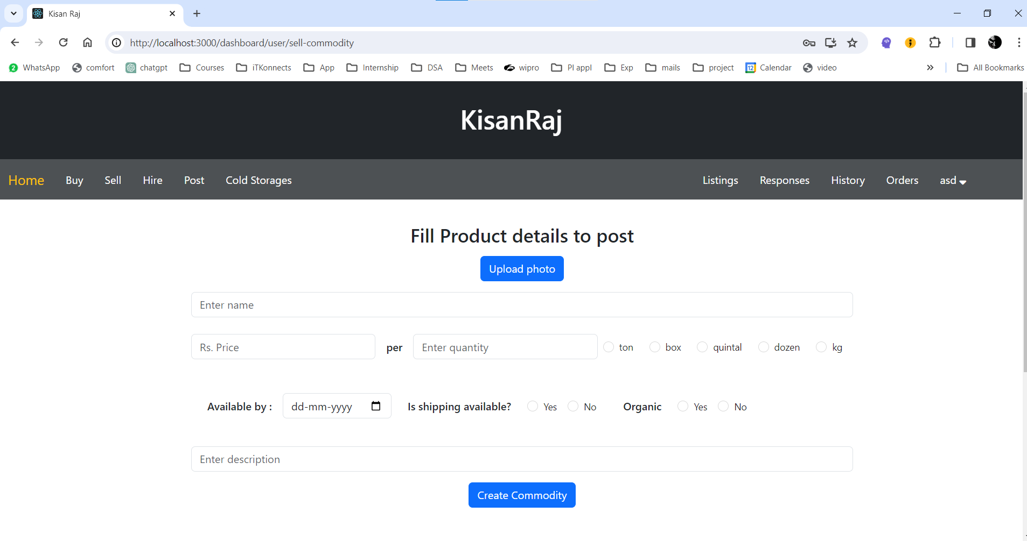
Modules : Sell Commodity
Sell Commodity Form: A form for users to input details about the commodity they wish to sell.
Data Storage: Upon submission, the entered data, including product and user details, is stored in the database.
Product Details: Captures information such as product type, quantity, quality, and price.
User Details: Collects information about the seller, including contact details and location.
Database Integration: Integrates with the backend database to ensure secure and efficient data storage.
Slide 8

Slide 9
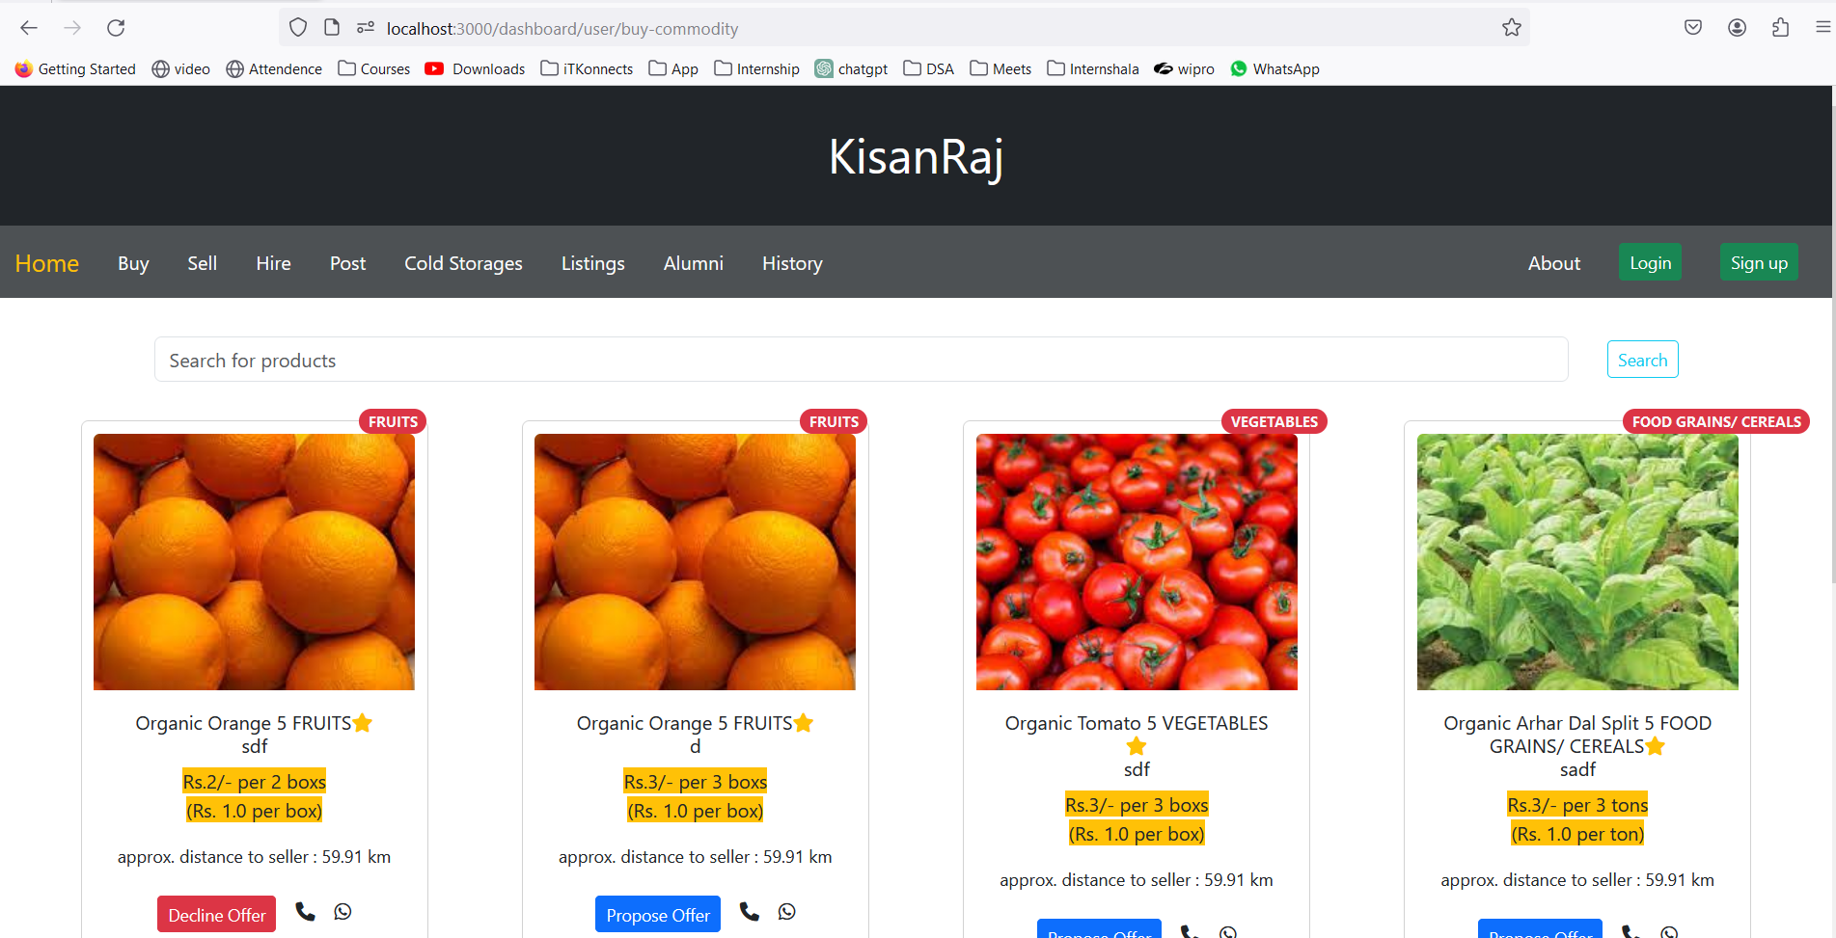
Modules : Listings Posted
Listings Posted: Displays a list of items that users have posted for sale.
User Listings: Each item is associated with the user who posted it.
Product Details: Shows details of the posted items, including product type, quantity, quality, and price.
Status Updates: Users can view the status of their listings, such as active or inactive.
Edit and Delete Options: Provides options for users to edit or delete their posted listings as needed.
Slide 9

Slide 10
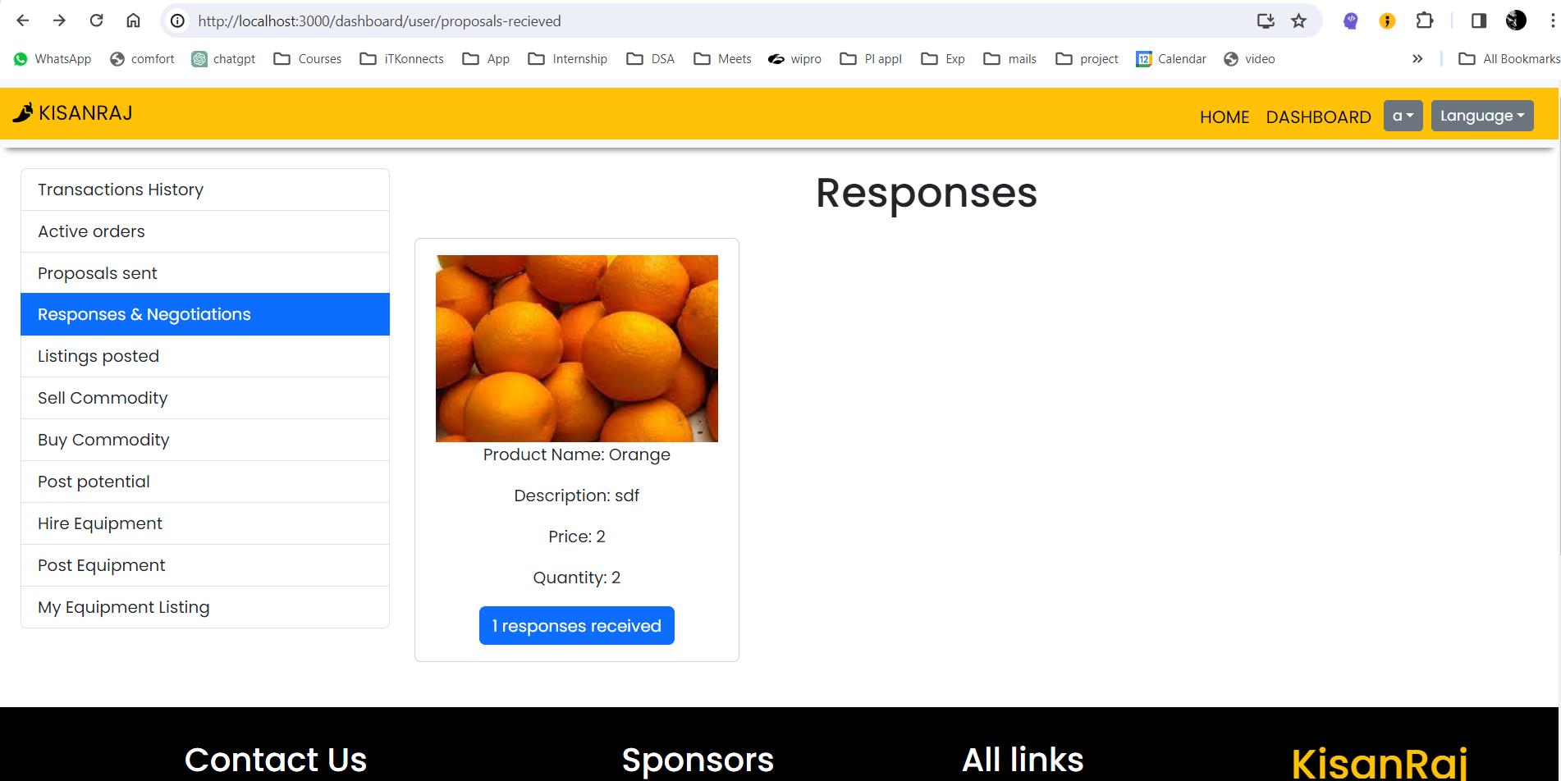
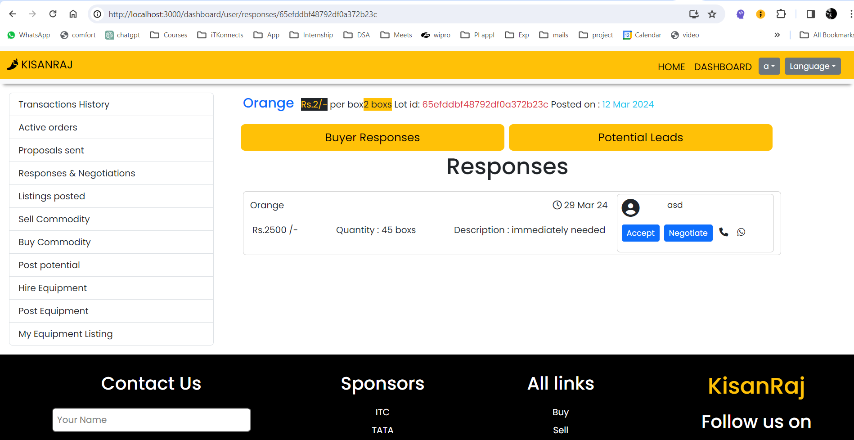
Modules : Responses Recieved
Buyer Inquiries: Displays inquiries received from potential buyers.
Inquiry Details: Includes details such as buyer name, contact information, and message.
Product of Interest: Specifies the product(s) the buyer is interested in.
Response Handling: Provides options for the seller to respond to inquiries, such as accepting, declining, or negotiating offers.
Communication Platform: Facilitates communication between sellers and potential buyers for further negotiation and transaction arrangements.
Slide 10

Slide 11
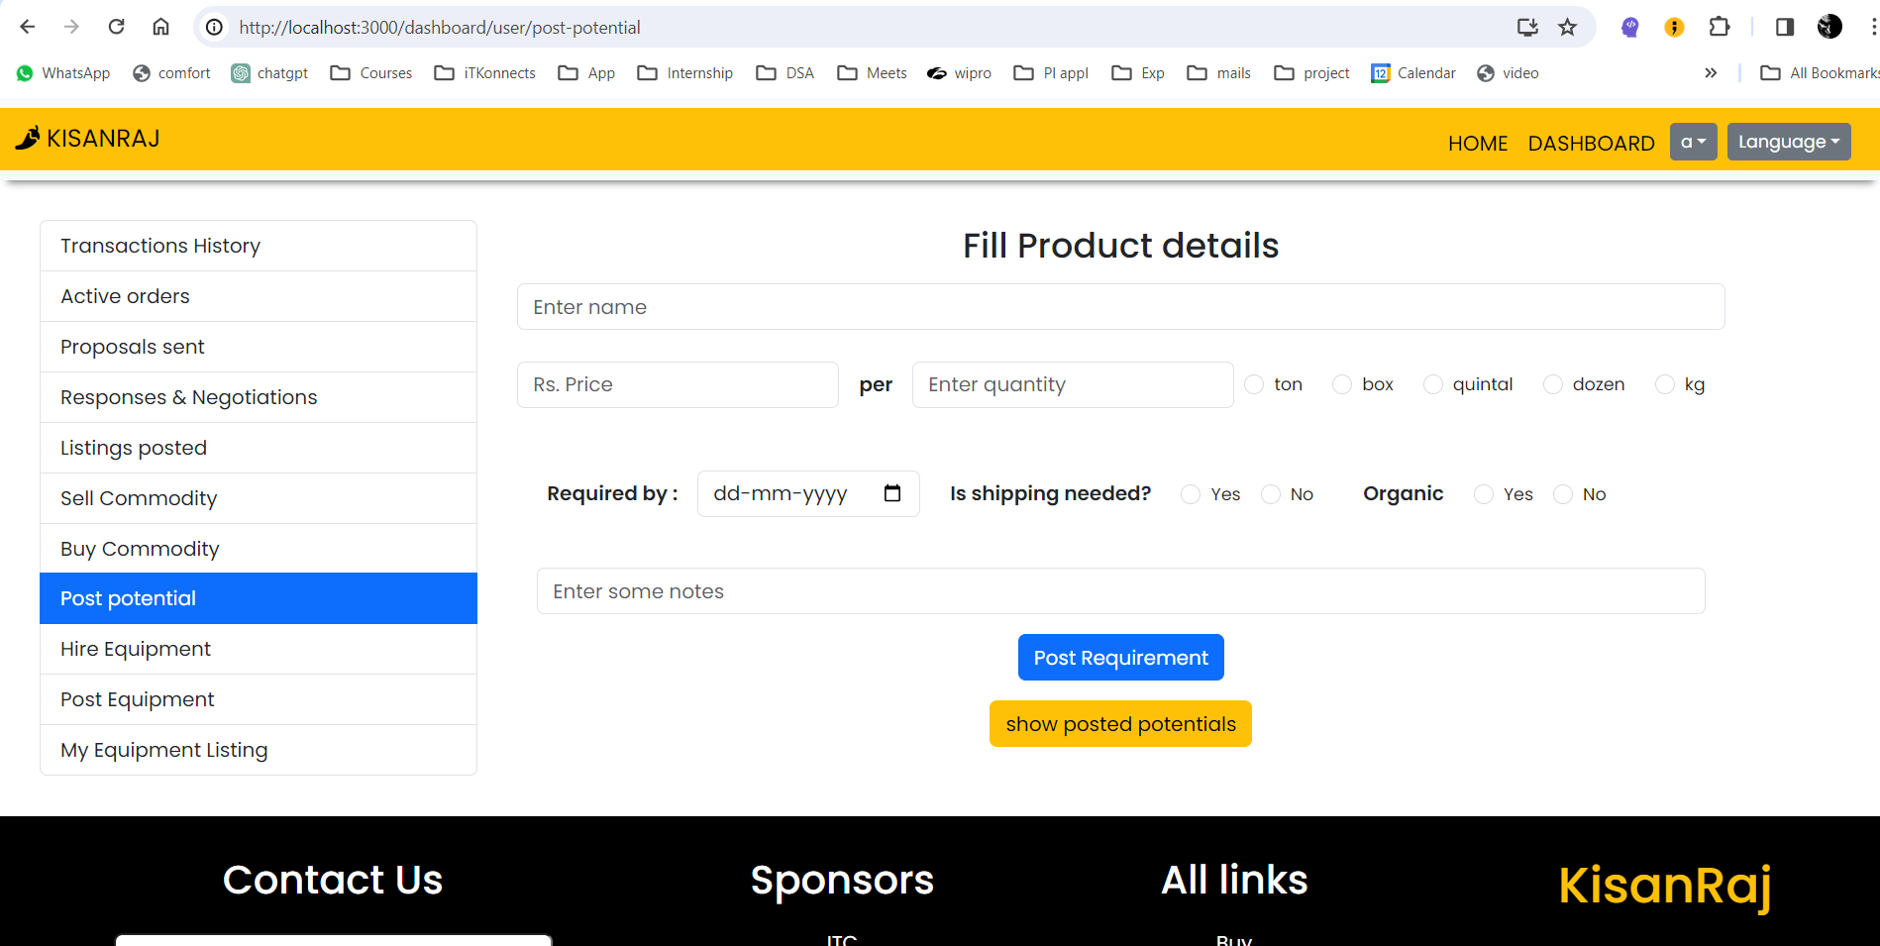
Modules : Post potentials
User Requirements: Enables users to submit their product requirements.
Listing Requirements: Allows sellers to view and list all requirements posted by users.
Requirement Details: Displays details of each requirement, including product specifications, quantity, and any additional notes provided by the user.
Matching Algorithm: Utilizes a matching algorithm to connect user requirements with suitable sellers, facilitating efficient transactions.
Transaction Initiation: Provides a platform for initiating transactions based on matched requirements, promoting trade between users.
Slide 11

Slide 12
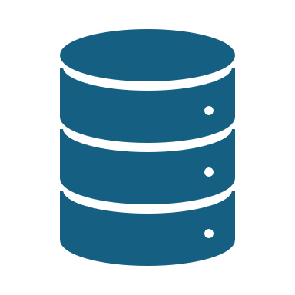
Data Management
Data Storage: MongoDB Atlas is utilized for storing all application data.
Database Operations: All database operations, including CRUD (Create, Read, Update, Delete) operations, are performed through MongoDB Atlas.
Data Security: MongoDB Atlas ensures robust security measures, including encryption, authentication, and access control, to safeguard sensitive data.
Scalability: MongoDB Atlas offers scalability features, allowing the application to handle increasing data volumes and user loads seamlessly.
Backup and Recovery: Automatic backup and recovery mechanisms provided by MongoDB Atlas help in safeguarding data against loss or corruption.
Real-time Data Access: The application accesses data in real-time from MongoDB Atlas, ensuring up-to-date information for users.
Cloud Integration: MongoDB Atlas seamlessly integrates with cloud platforms, providing flexibility and scalability for application deployment and management.
Slide 12

Slide 13

conclusion
Our project aims to modernize the Indian agricultural supply chain through an online platform, promising to revolutionize farmer-buyer interactions. Leveraging advanced technologies and integrating features like direct communication, secure transactions, and E-NAM, we empower farmers, enhance market access, and ensure transparency and efficiency. With a focus on sustainability and scalability, our initiative signifies a crucial stride towards a more inclusive, resilient, and prosperous agricultural ecosystem in India.
Slide 13

Slide 14

Thanking You
Slide 14

